Slide 1
Back compatibility and material library rev 261
July 28 2016
simone.ferrari@polito.it

Slide 2
Content
Back compatibility with project saved using older version of SyR-e
New material library
New material tab in GUI

Slide 3
Back compatibility
When SyR-e load an old files, the function ‘back_compatibility’
[dataSet,geo,per,mat] = back_compatibility(dataSet,geo,per)
add the new field in dataSet, and rewrite geo, per and mat (material)
The new fields are set using geo or default values.
If in the future version some fields in dataSet are added, remember to add this field also in back_compatibility.m

Slide 4
Material library
mat structure is added and all the material properties are saved inside it.
The material properties are saved in 3 function (material_properties_iron.m, material_properties_conductor.m and material_properties_layer.m)
Iron properties: yield strength (sigma_max), mass density (kgm3), loss factor (kh,ke,alpha,beta), BH curve
Conductor propertied: mass density (kgm3), conductivity (sigma)
Layer properties: remeance (Br), coercivity (Hc), relative permeability (mu), mass density (kgm3)
Empty_case.fem is now DELETED to have only one material library

Slide 5
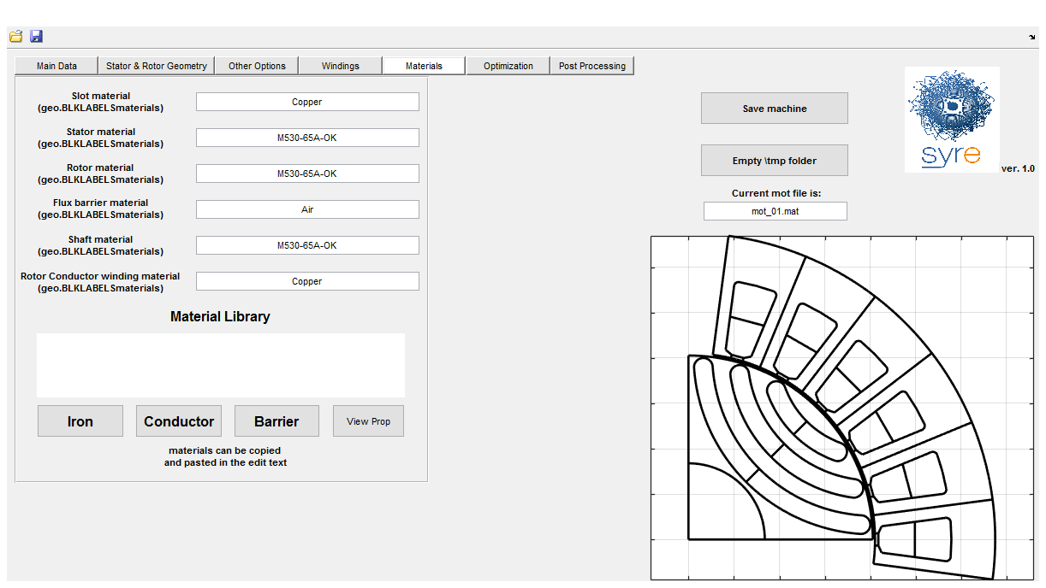
New material tab in GUI
1 button to show the properties of 1 material
3 button to show the materials name

